Slide 1
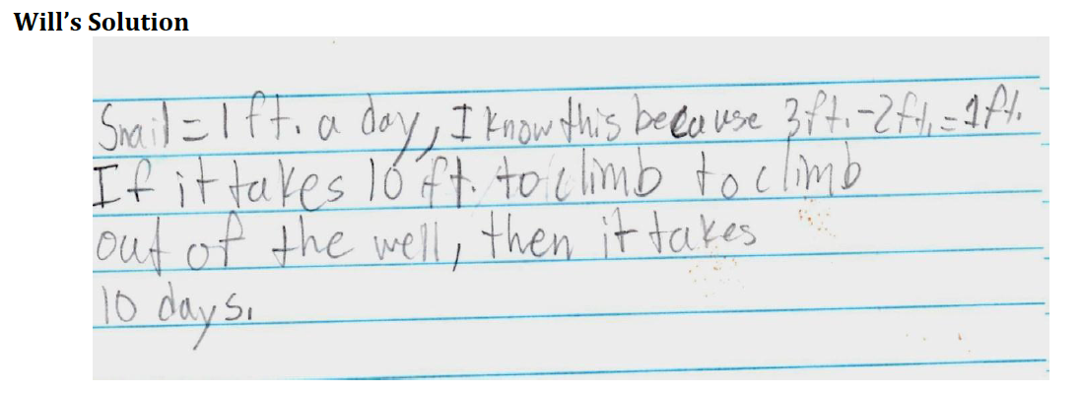
Snail in a Well
A snail is at the bottom of a well that is 10 feet deep. Each day he crawls up 3 feet and each night he slides back 2 feet. How many days will it take him to reach the top of the well? Show your work to defend your answer. (justify)

Slide 2
